Slide 1
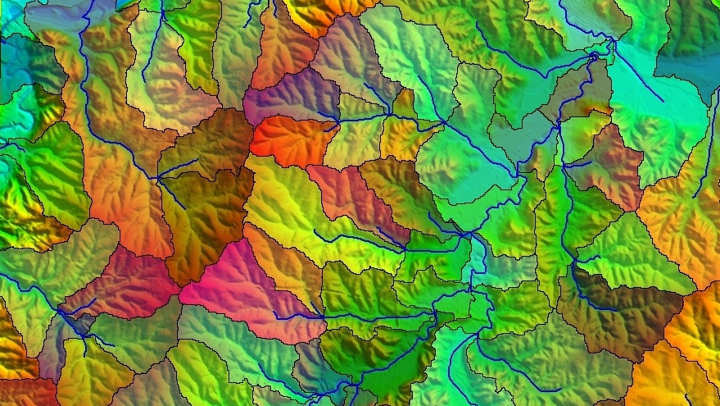
Watershed Analysis

Slide 2
GROUP - 15
ANKIT CE21BTECH11057
REVANTH KUMAR CE21BTECH11036
PUSHPENDRA BAIRWA CE21BTECH11033

Slide 3
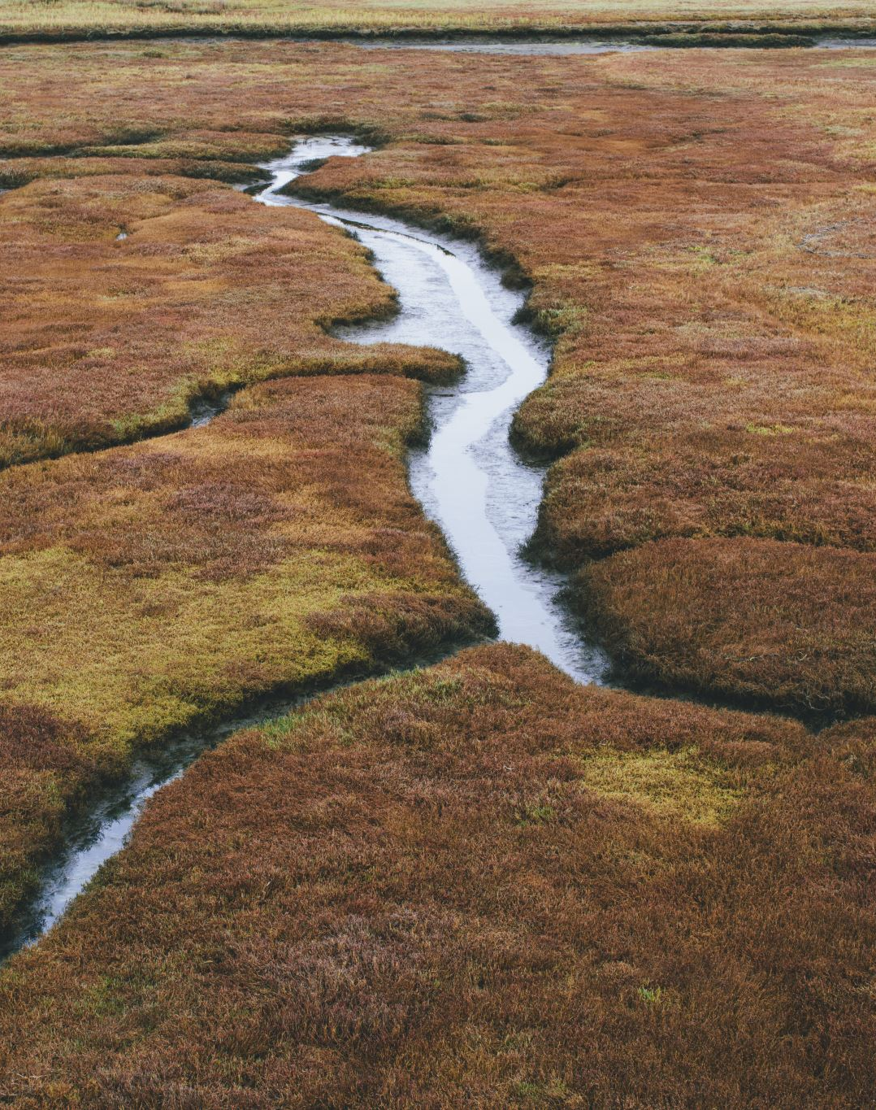
What is a watershed?
A watershed is the area of land where all of the water that falls in it and drains off of it goes into the same place or common outlet. A watershed is also defined by topographic divides between two or more adjacent catchment basins, such as a ridge or a crest.
In simple words watershed is a region of land within which water flows down into a specified body, such as a river, lake, sea, or ocean; a drainage basin.

Slide 4
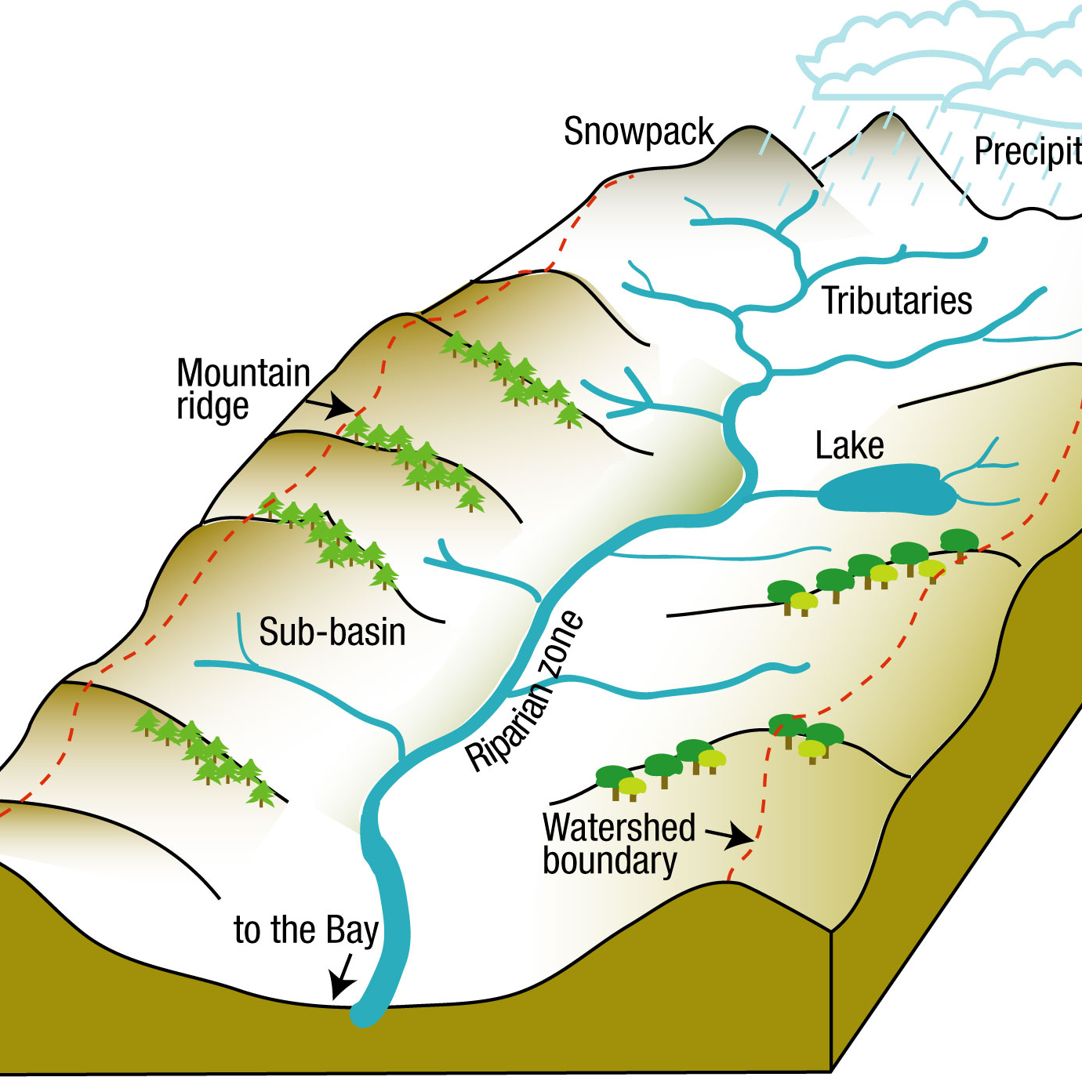
Watershed analysis
Watershed analysis refers to the process of using DEM and raster data operations to delineate watersheds and to derive features such as streams, stream network, catchment areas, basin etc.
Delineation of watersheds can take place at different spatial scales. A large watershed may cover an entire stream system and, within the watershed, there may be smaller watersheds, one for each tributary in the stream system.

Slide 5
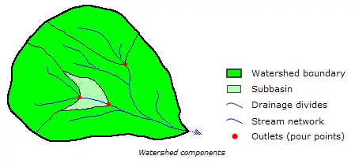
Components of Watershed
Broadly a watershed have five components:
Watershed boundary,
Subbasin,
Drainage divides,
Stream network,
Outlets (pour points).

Slide 6
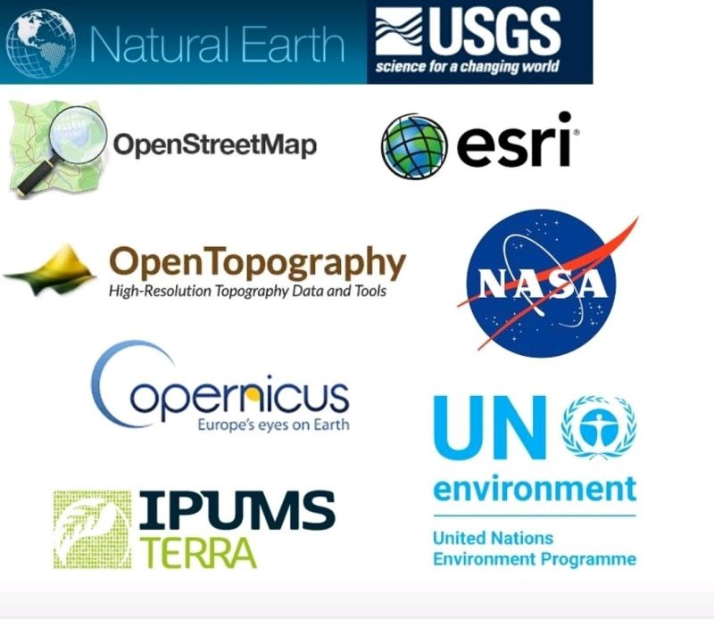
Downloading DEM files:
Login into USGS Earth Explorer.
Select the required region of Interest using cursor.
Go to datasets and click on the digital elevation then SRTM.
Go to results and download the respective DEM files.

Slide 7
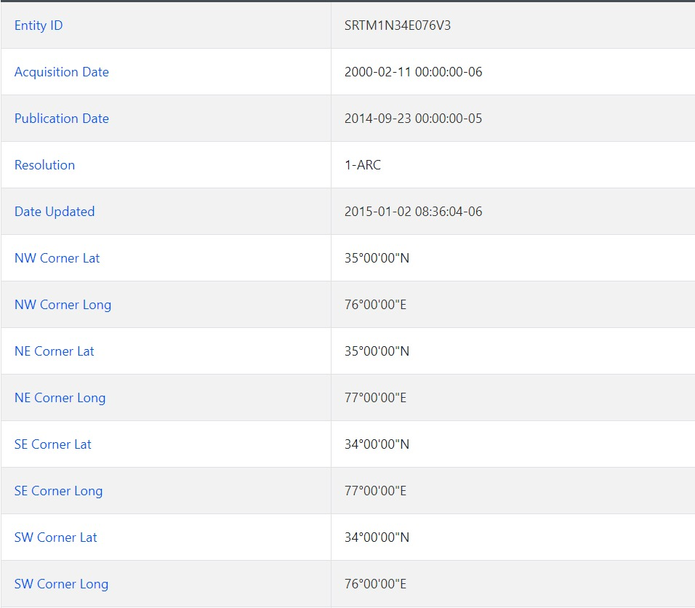
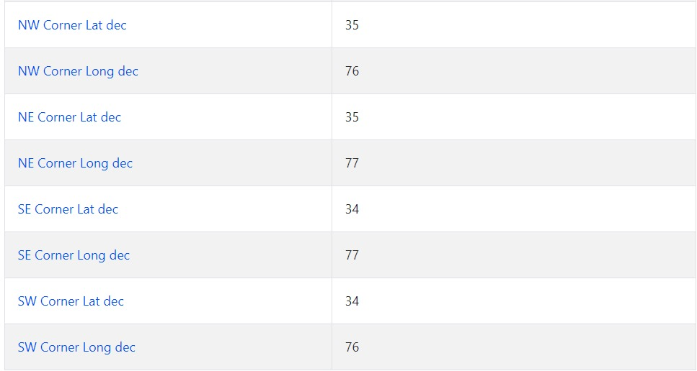
Meta Data Of the Study Region:

Slide 8
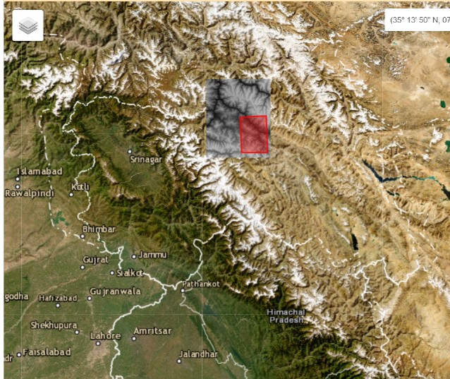
Map of the Selected Region:

Slide 9
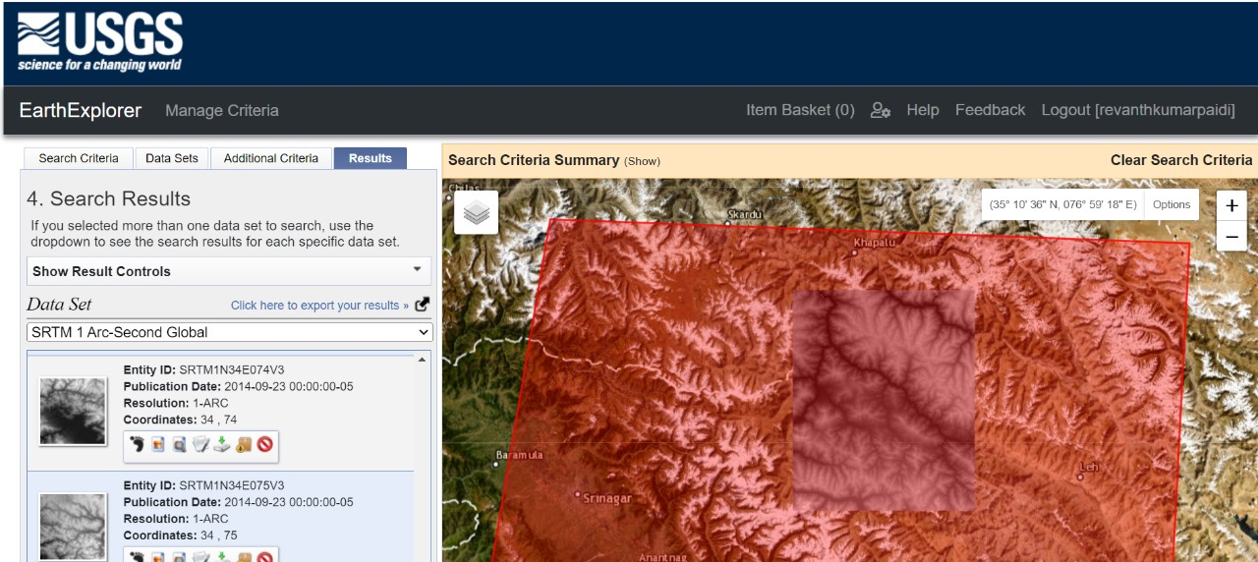
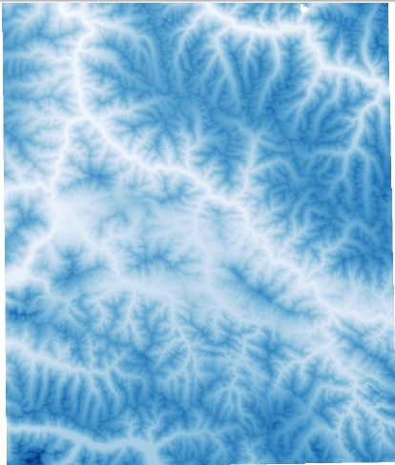
SRTM 1 Arc-Second Global
USGS User Interface
Entity ID: SRTM1N34E076V3

Slide 10
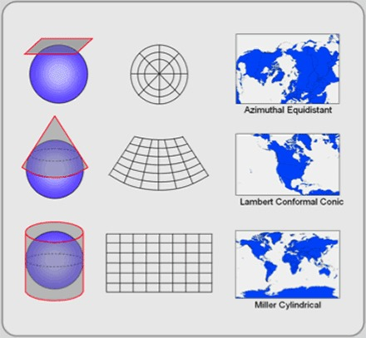
Projections
Click on Raster tool and move to warp(Reproject).
In warp(Reproject) window, select the respective layer and target CRS.
Now create a new file to save the Reprojected DEM.
Now run the algorithm.

Slide 11
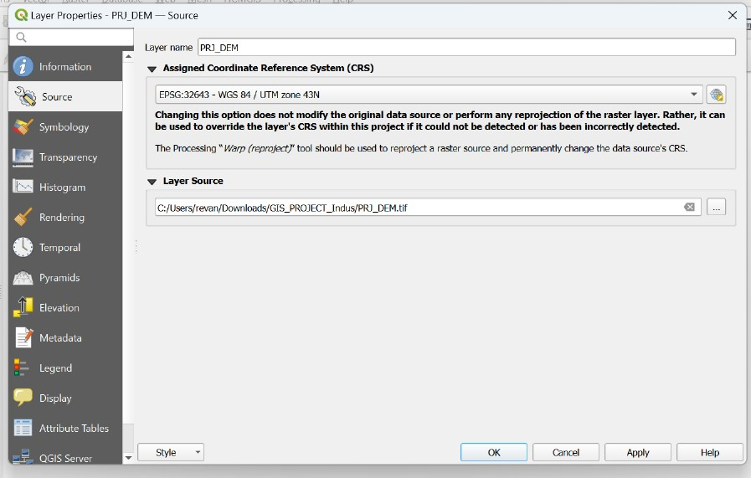
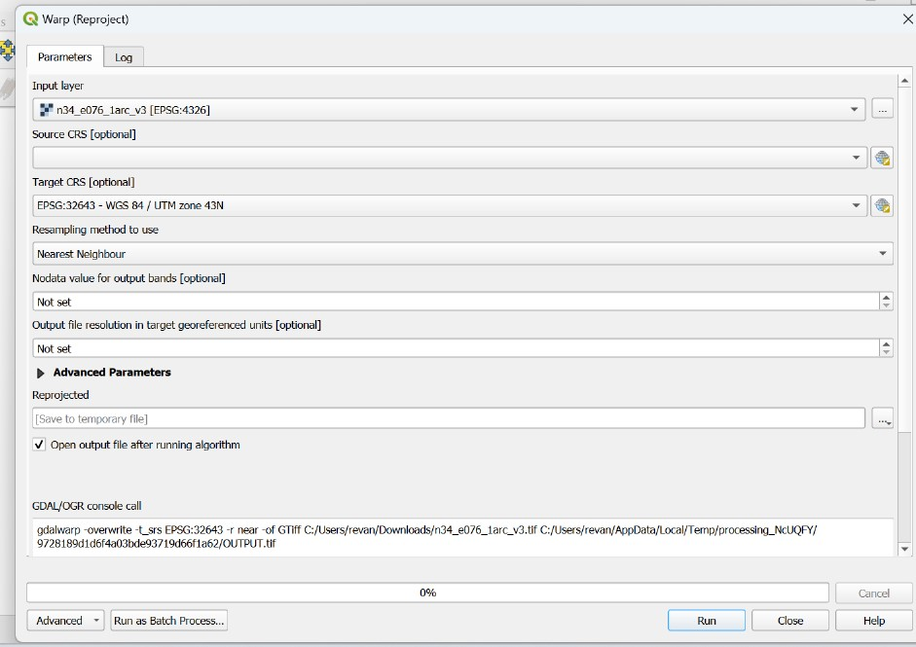
Projections

Slide 12
Filling sinks in DEM
Sinks should be filled to ensure proper delineation of basins and streams. If the sinks are not filled, a derived drainage network may be discontinuous. The Fill tool uses the equivalents of several tools, such as Focal Flow, Flow Direction, Sink, Watershed, and Zonal Fill, to locate and fill sinks.
In this project we had used fill sinks(Wang & Liu) tool provided in SAGA plugin to fill all the sinks in DEM.

Slide 13
Steps Involved
Open fill sinks(Wang & Liu) in SAGA.
Select the respective projected DEM file.
Uncheck the flow directions and water basins.
Create a new file to save filled the DEM file.
Run the algorithm.

Slide 14
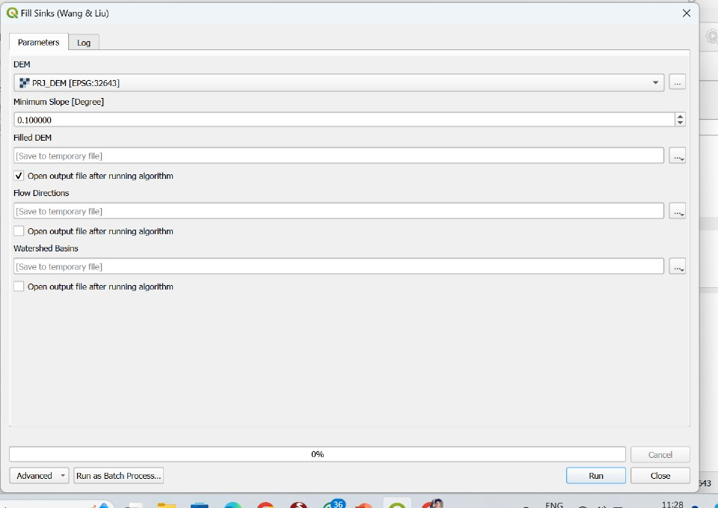
Fill sinks(Wang & Liu) Window

Slide 15
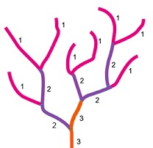
Strahler stream order
Stream ordering is a method of assigning a numeric order to links in a stream network. This order is a method for identifying and classifying types of streams based on their numbers of tributaries.
When two streams with different orders join, the resulting stream has the same order as the highest order of the two joining streams.

Slide 16

Steps Involved
Open Strahler order window provided by SAGA plugin.
Now select the respective filled DEM file.
Create a new file to save the Strahler order output file.
Run the algorithm.

Slide 17
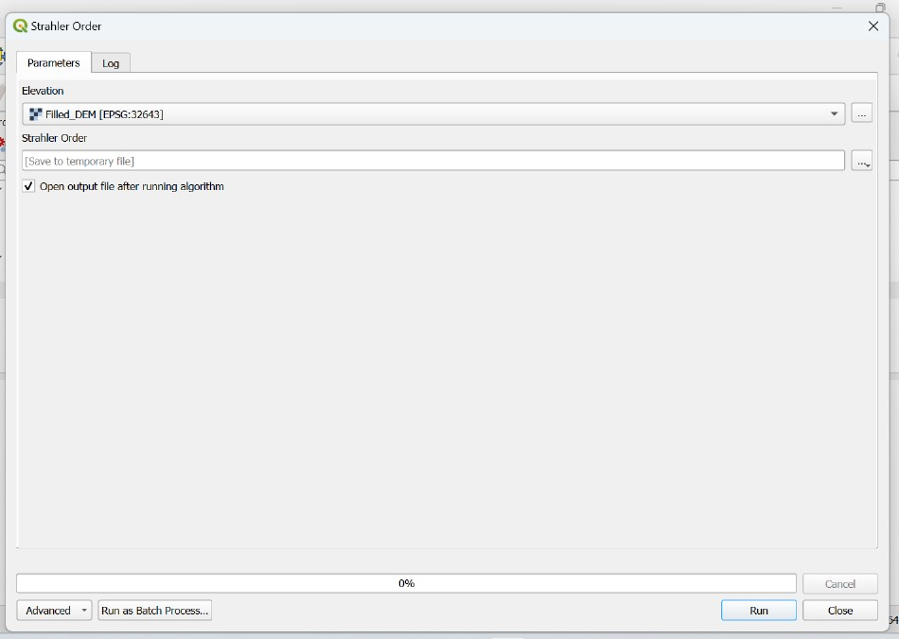
Strahler Order Window

Slide 18
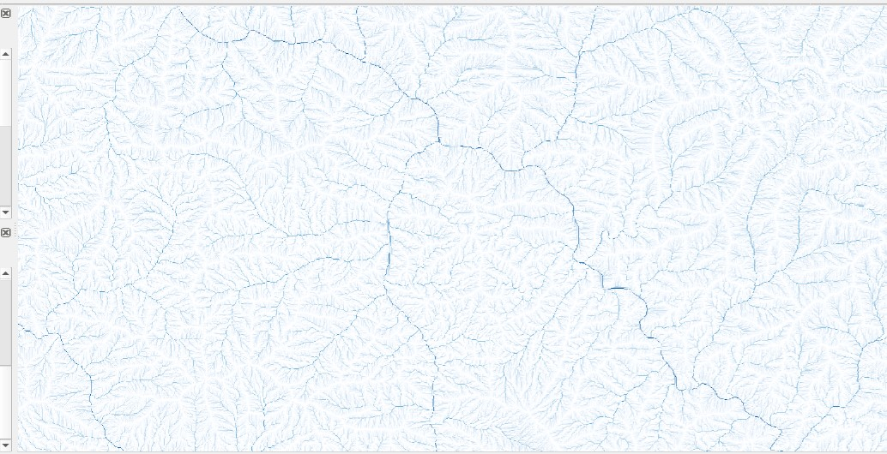
Output

Slide 19

Fixing Threshold on stream order
In raster tab, open raster calculator.
In raster bands select the Strahler order file.
In raster calculator expression give the suitable condition.
Now create a new file to save the output layer.
Click on ok.

Slide 20
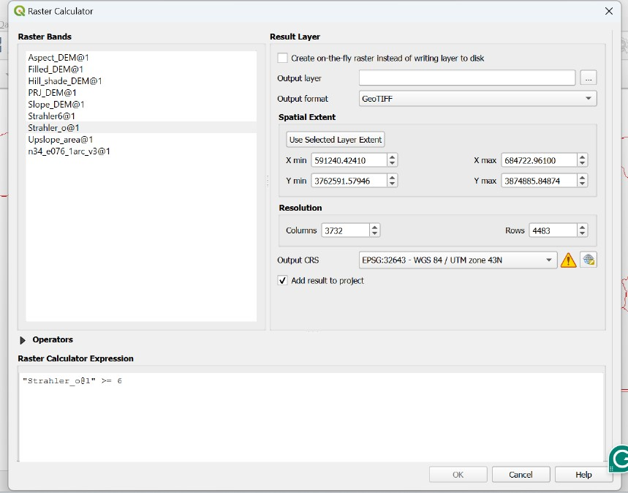
Raster Calculator Window

Slide 21
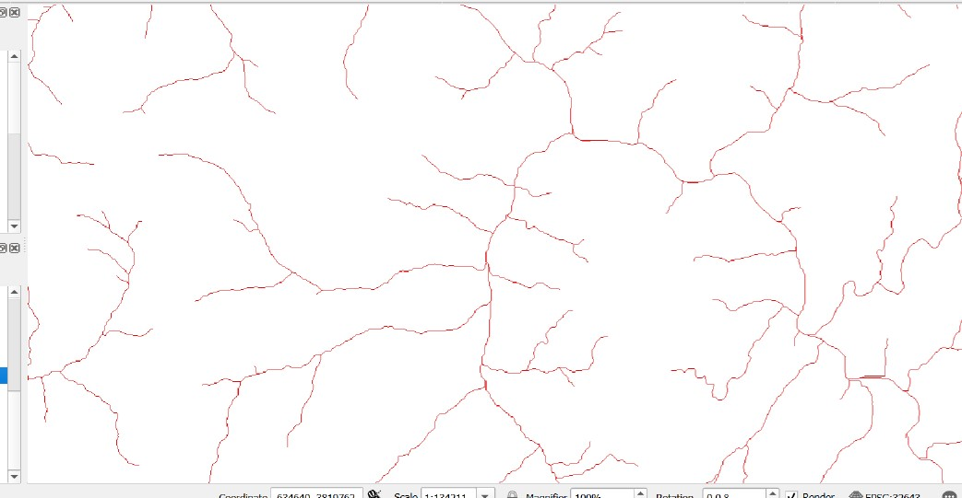
Output Layer

Slide 22
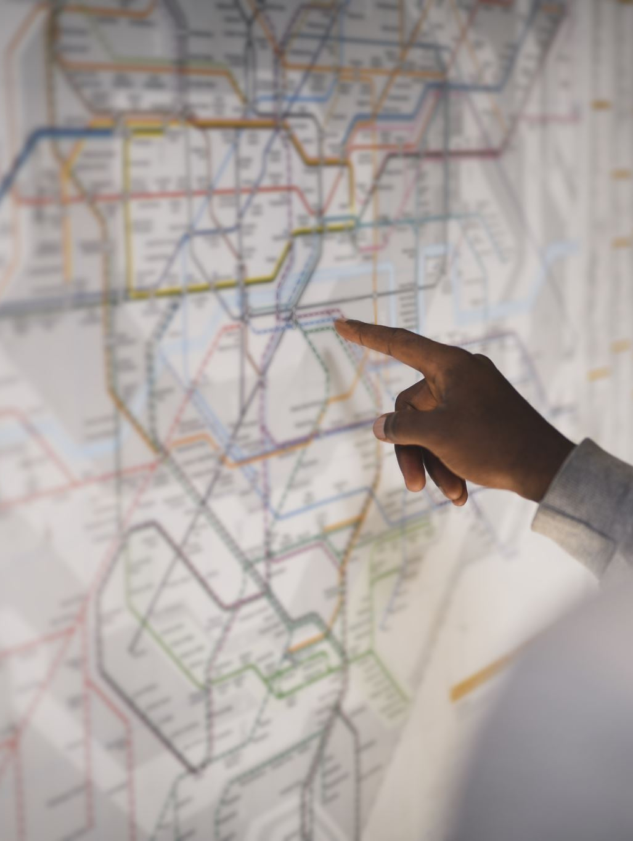
Deriving watershed boundary
Select an outlet point on the main stream and note its coordinates in meter.
Select the Upslope area tool in SAGA.
In Upslope area window enter the noted coordinates in the target X and Y coordinates.
Create a new file to save the output layer.
Run the algorithm.

Slide 23
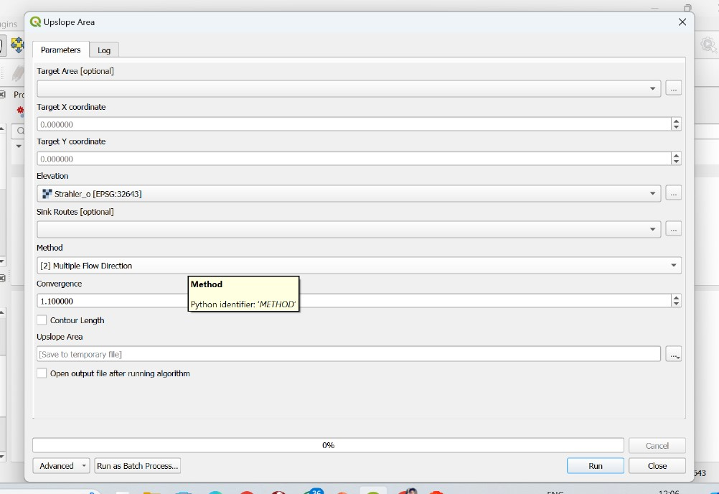
Upslope Area Window

Slide 24
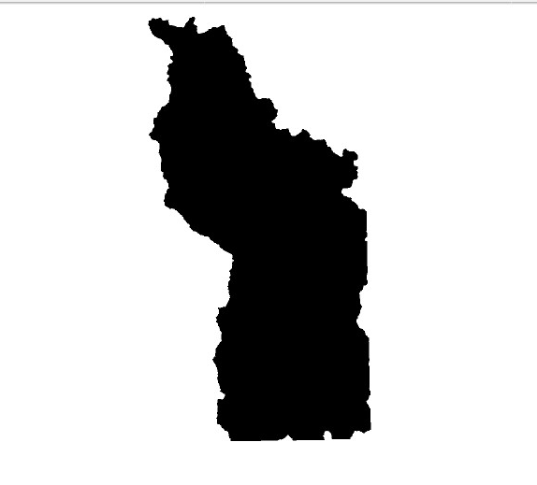
Output Layer
The output layer is in raster format. To perform any analysis we need to convert it into vector by using polygonise(Raster to vector) tool.

Slide 25

Deriving Channel Network
Open channel network and drainage basin tool in SAGA.
Select the respective filled DEM file and enter threshold as six.
Uncheck all the boxes except channels.
Create a new file to save the channel network layer.
Run the algorithm.

Slide 26
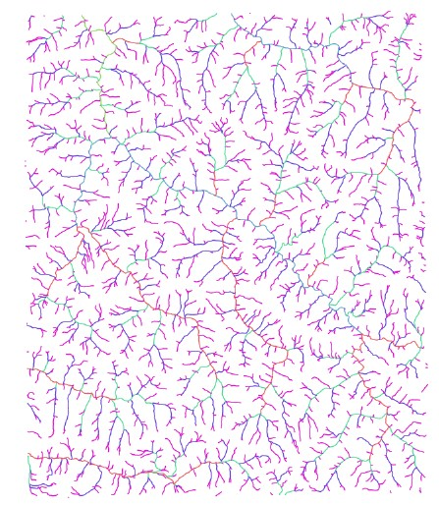
Output Layer

Slide 27
Clipping the Channel Network
Open processing toolbox and search polygon clipping.
Click on polygon clipping tool provided in SAGA.
In polygon clipping window select the watershed layer(vector) as clip feature and channel layer as input features.
Create a new file to save the output features.
Run the algorithm.
After completion we obtain the clipped channel network.
Now perform appropriate styling to obtain the final watershed/catchment.

Slide 28
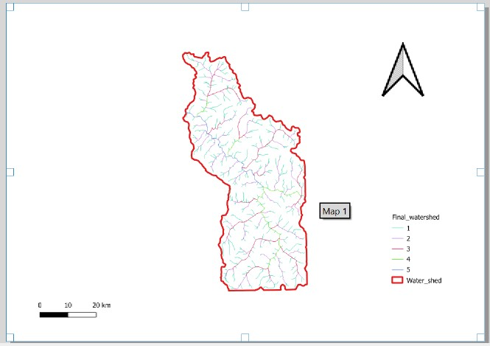
Delineated watershed using DEM data

Slide 29
Catchment Area Calculation
Right click on watershed boundary layer(vector).
Click on properties and click on attribute table.
Enable toggle editing mode and click on open field calculator.
Create a new field with a name basin area.
Fix appropriate field length and precision.
In geometry click on $area tool.
Click on ok and close.
Now, a new field with basin area is created in the attribute table which contains the catchment area.
Save and close the window.

Slide 30
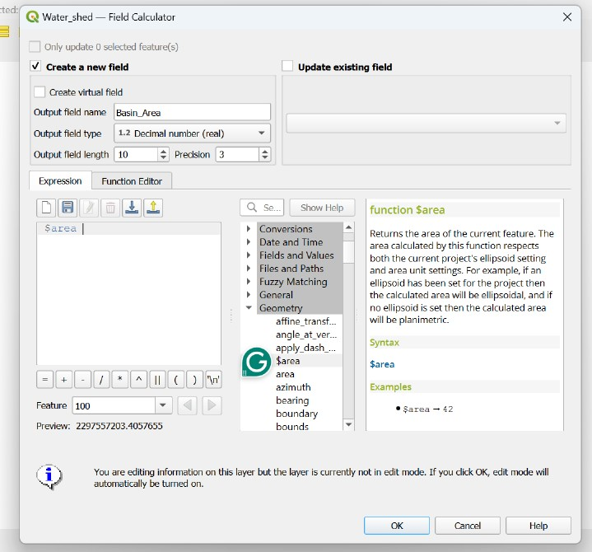
Field calculator window

Slide 31
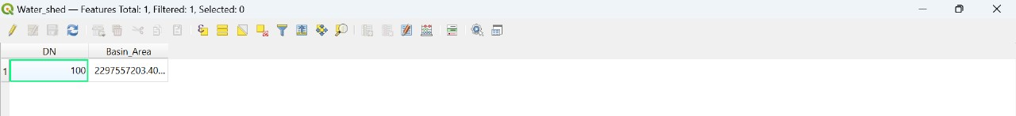
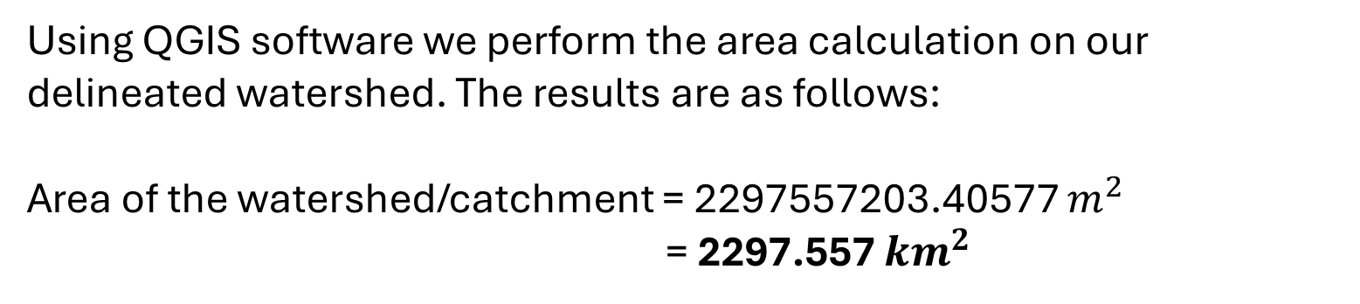
Result
Using QGIS software we perform the area calculation on our delineated watershed. The results are as follows:
Area of the watershed/catchment = 2297557203.40577 $m^{2}$
= 2297.557 ${km}^{2}$

Slide 32
Total stream length calculation
Open the attribute table of channel layer.
In that layer there is complete information about length of all streams.
We will dissolve all the streams data into a single file using dissolve tool provided in geoprocessing tools.
In dissolve window select channels as input layer and create a new file to save the dissolved layer.
Open the attribute table of dissolved layer and open field calculator.
Create a new field named total stream length.
In geometry select $length and click on ok.
Now a field named total stream length created in attribute table which contain total length of all the streams in the catchment.

Slide 33
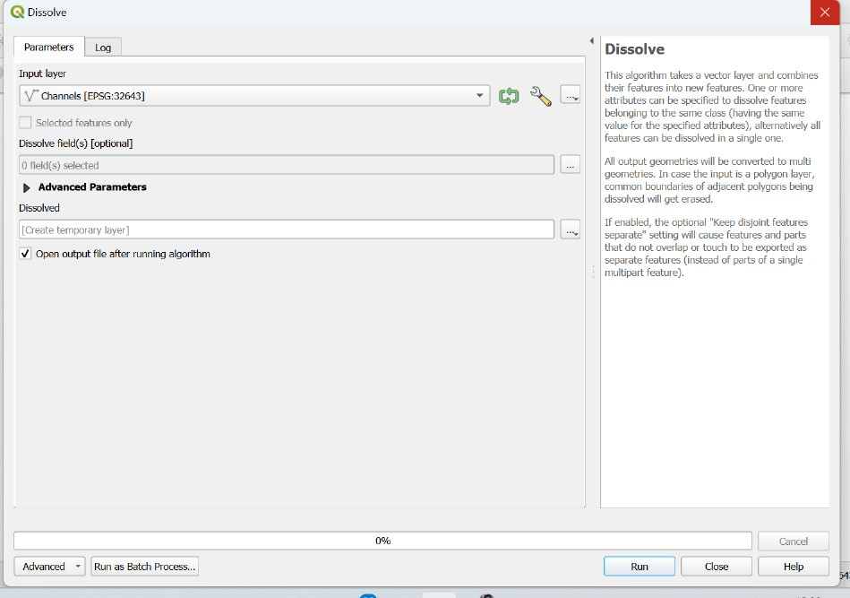
Dissolve Window

Slide 34
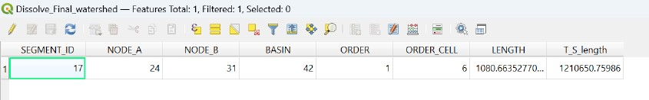
Result
Using QGIS software we perform total stream length calculation on our delineated watershed. The results are as follows:
Total length of all streams = 1210650.75986 m
= 1210.651 km

Slide 35
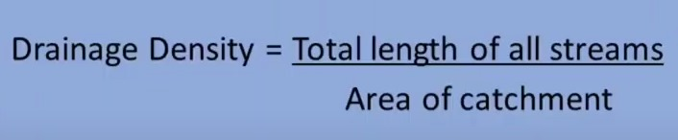
Drainage density
Drainage density, D-d , is defined as the total length of channels per unit area, and it describes the drainage spacing and distribution in a catchment.

Slide 36
Drainage density calculation
We have basin area and total length of all streams in two different attribute tables.
In order to calculate the drainage density we intersect both the layers using intersection tool and bring both fields under one attribute table.
After performing intersection open field calculator and create a field named drainage density.
Apply the D-d formula in field calculator and click on ok.
Now we can see a new field named D-d which contain the drainage density of the catchment.

Slide 37
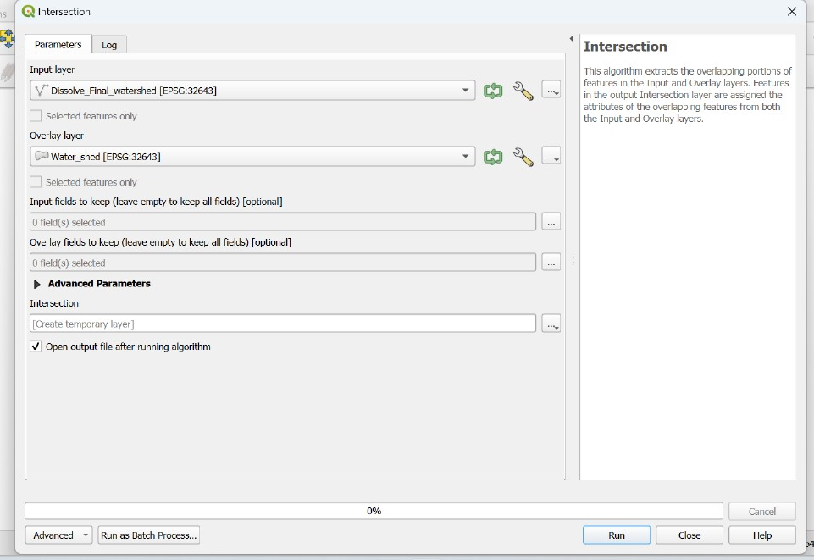
Intersection Window

Slide 38
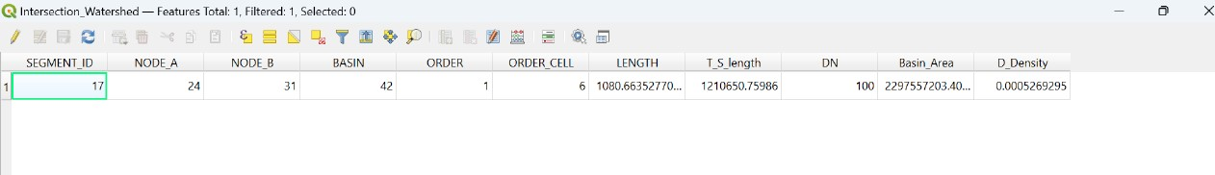
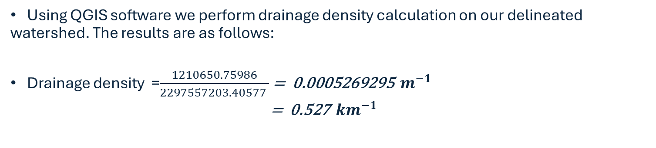
Result
Using QGIS software we perform drainage density calculation on our delineated watershed. The results are as follows:
Drainage density =$\frac{1210650.75986}{2297557203.40577 }$ = 0.0005269295 $m^{−1}$
= 0.527 ${km}^{−1}$

Slide 39
Bifurcation ratio
The bifurcation ratio is a dimensionless number that denotes the ratio between the number of streams of one order and those of the next higher order in a drainage network. It is a useful measure of proneness to flooding, with higher values indicating a greater probability of flooding.
A high bifurcation ratio indicates that the watershed is highly dissected, with many small streams and tributaries, which can lead to a higher risk of flooding. On the other hand, a low bifurcation ratio indicates a less dissected watershed with fewer streams and tributaries, which may be less prone to flooding.

Slide 40

Bifurcation ratio calculation
Open statistics by categories tool provided in vector analysis.
Select channels layer as input vector layer and select order in fields with categories tab.
Create a .csv file to save the computed statistics.
Run the algorithm.
After closing a new csv file is created containing the frequency of each stream.
Using the data we can create a histogram.

Slide 41
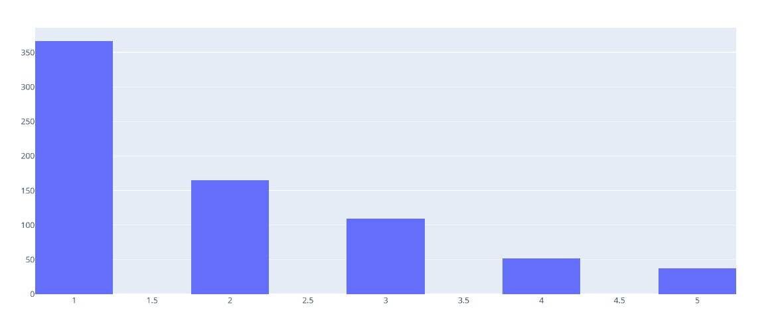
Generating the Histogram
Open vector layer histogram provided in plots.
In vector layer histogram window select channels as input layer and order as the attribute.
Create a .html file to save the generated histogram.

Slide 42
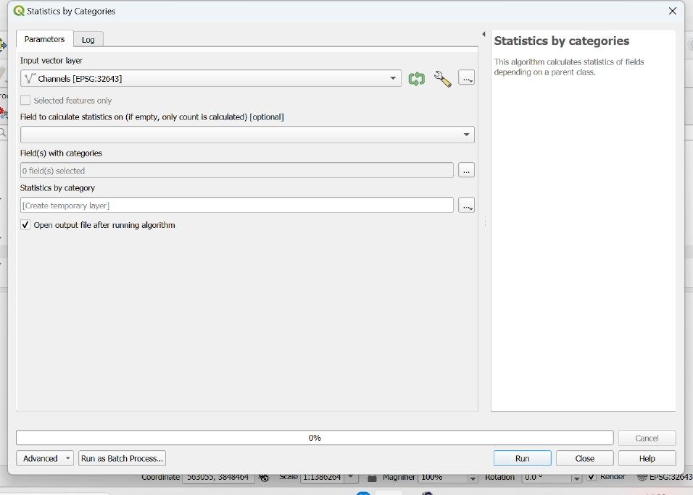
Statistics by categories window

Slide 43
Bifurcation ratio calculation
Right click on the created .csv file and open attribute table.
Enable toggle editing mode and open field calculator.
Create a new field named bifurcation ratio and compute the ratio using above formula.
Click on ok and save it.
We can see a new field named bifurcation ratio containing the values in the attribute table.

Slide 44
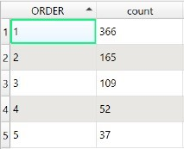
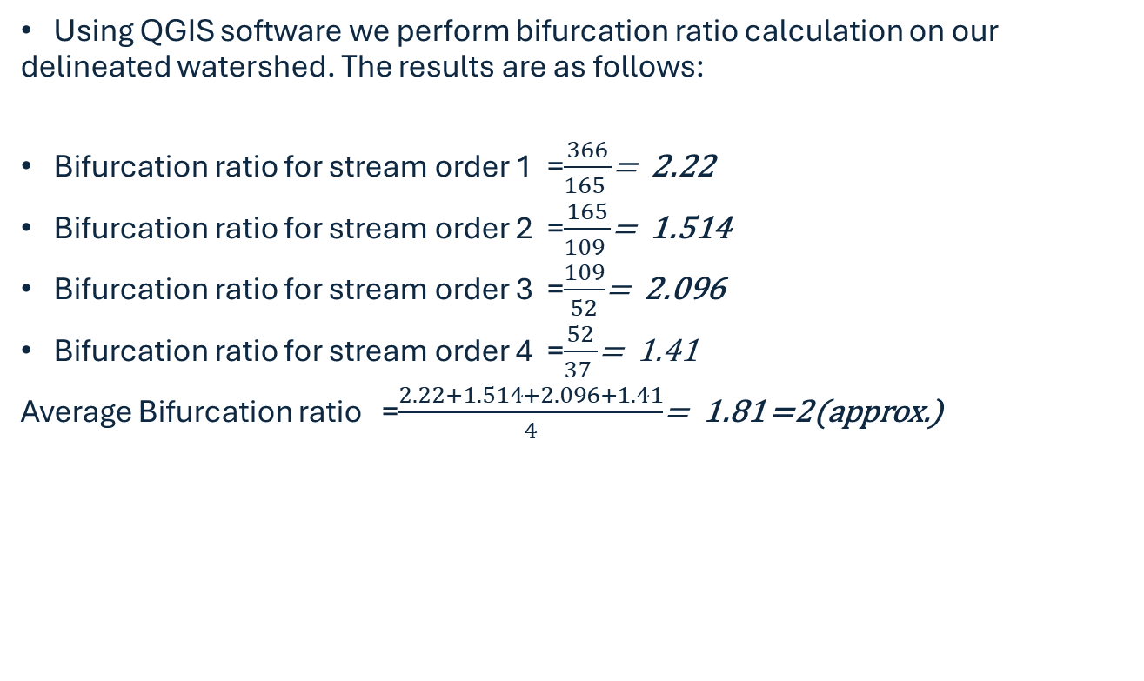
Results
Using QGIS software we perform bifurcation ratio calculation on our delineated watershed. The results are as follows:
Bifurcation ratio for stream order 1 =$\frac{366}{165 }$= 2.22
Bifurcation ratio for stream order 2 =$\frac{165}{109 }$= 1.514
Bifurcation ratio for stream order 3 =$\frac{109}{52}$= 2.096
Bifurcation ratio for stream order 4 =$\frac{52}{37 }$= 1.41
Average Bifurcation ratio =$\frac{2.22+1.514+2.096+1.41}{4}$= 1.81 =2(approx.)

Slide 45
Comments on the catchment based on above results
A low bifurcation ratio like 2(two) indicates fewer subdivision between stream orders, suggesting a less complex stream network in the catchment.
Low drainage density often indicates that the soil in the catchment has higher infiltration capacity allowing more water to seep into the ground instead of forming surface runoff. Thus this catchment might contribute to groundwater recharge.
A catchment with these characteristics may produce slower and more gradual runoff patterns due to the lower density of streams. This could mean a reduced risk of flash flooding compared to catchments with higher drainage densities.
The low drainage density suggests that the terrain in this catchment might be more permeable, allowing more water to infiltrate the ground rather than forming surface runoff.
A low bifurcation ratio, coupled with low drainage density, generally indicates a catchment with less intense stream branching and possibly lower erosion rates.

Slide 46
Individual Contribution:
Ankit:
Downloading the DEM data from the USGS Earth Explorer.
Converting it into suitable projection systems and Filling the Sinks in the DEM file.
Assigning Strahler’s stream order to the filled DEM file.
Fixing a threshold to Strahler’s order and extracting the streams of order greater than the threshold limit.
Revanth Kumar :
Choosing an Outlet point and extracting the Catchment boundary(upslope area) in Raster and converting it into a vector.
Deriving the Channel network from the DEM file and clipping it with the Catchment boundary.
Delineating the Watershed/Catchment.
Performing Bifurcation Ratio Calculation using statistics by categories and open field calculator.
Developing the Order-Frequency Histogram.
Applying Styles to final Delineated watershed.
Pushpendra:
Catchment Area Calculation.
Calculation of Total length of all streams in a catchment.
Catchment Drainage-Density Calculation.

Slide 47
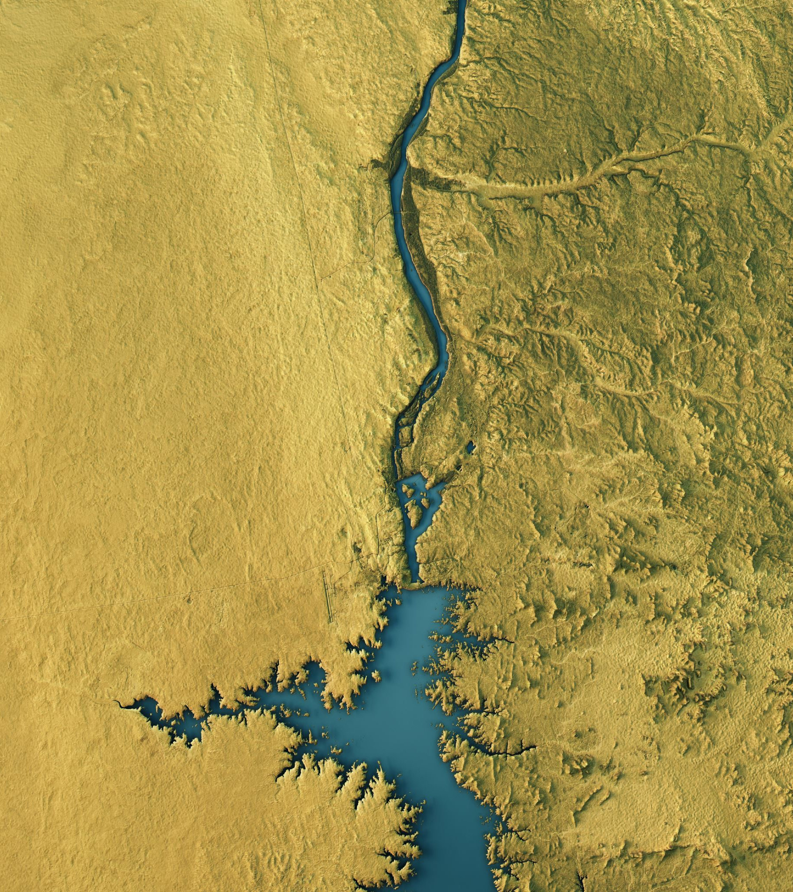
Application of Watershed Analysis
Watershed analysis is used for the management and planning of natural resources.
To provide necessary inputs for hydrological modeling.
Flood prediction modeling.
Watershed analysis provides catchment boundaries but also hydrological parameters useful for management programs.

Slide 48


